Slide 1

DATA ANALYTICS PROJECT
By Hieu Nguyen
Airbnb Listing Trends and Pricing Insights for First-Time Hosts

Slide 2
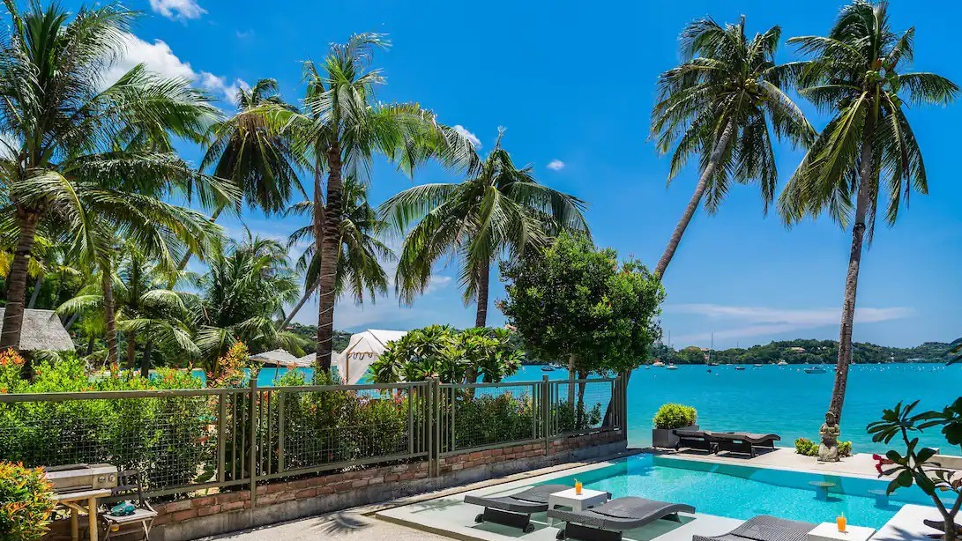
AGENDA
Problem
Goals
Data
Findings
Recommendations

Slide 3
PROBLEM STATEMENT
First-time Airbnb hosts are unsure how and what they need to consider when pricing their rental on the platform.

Slide 4
GOALS
Goal 1: To extract and share relevant insights from the Airbnb listing data which can help with decision-making.
Goal 2: To provide pricing recommendations to first-time hosts so they can maximize their long-term rental revenue.
Main Questions:
What factors have more influence on price, and how do the relationships vary across different settings?
How should first-time Airbnb host price their property so that they can get appropriate revenue?

Slide 5
DATA: OVERVIEW
Data: Airbnb Listings in Bangkok, Thailand
Source: insideairbnb.com
Date: September 22, 2023
Size: 75 columns, 20,824 rows
Fields: neighbourhood, room type, price, bedrooms, bathrooms, accommodates, minimum nights, number of reviews, etc.

Slide 6
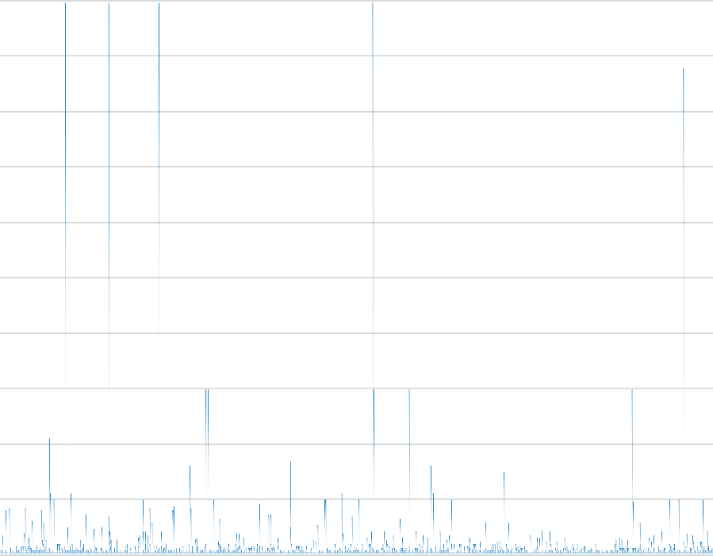
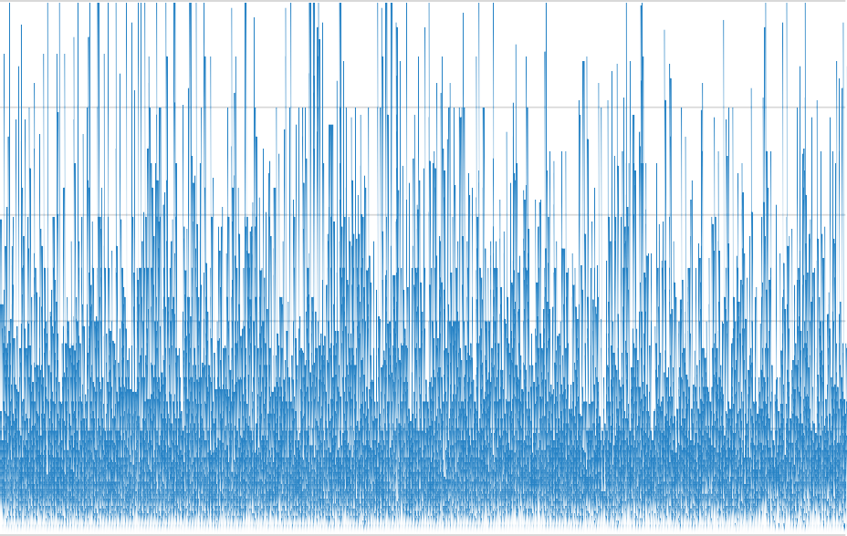
DATA: EXTREME OUTLIERS
Price Distribution (Before)
Price Distribution (After)
$1,000,000
$12,000.00
$900,000
$800,000
$700,000
$10,000.00
$8,000.00
$600,000
$500,000
$6,000.00
$400,000
$300,000
$4,000.00
$200,000
$2,000.00
$100,000
$0
$0.00

Slide 7


DATA: MAJOR CHANGES
Dropped 48 irrelevant and incomplete columns
Removed all hotel-related listings (obvious ones)
Removed listings with certain values in an abnormal range Replaced values above 30 in “minimum_nights” with 30
Added “region” column to categorize districts into groups
Added “min_night_cat” to categorize minimum nights into groups

Slide 8
FINDINGS: PRICE OVERALL
Price Histogram
2500
Average
price (after cleaning)
Mean | 1748.05207
Standard Error | 10.7841006
Median | 1300
Mode | 1000
Standard Deviation | 1426.43937
Sample Variance | 2034729.28
Kurtosis | 8.35381215
Skewness | 2.58078512
Range | 10000
Minimum | 216
Maximum | 10000
Sum | 30583919
Count | 17496
2000
1500
1000
$4,000
500
0

Slide 9

Insight #1: Most listings are available for short-term stay
Listing Count by Stay Term
FINDINGS: STAY TERM
4367, 25%
12498, 71%
long-term mid-term short-term
630, 4%

Slide 10
FINDINGS: STAY TERM
Insight #2: Short-term listing has the highest average price and average reviews per month.
Stay term | Average price | Reviews per month
long-term | 1428.23 | 0.32
mid-term | 1611.00 | 0.50
short-term | 1866.85 | 0.80
total | 1748.15 | 0.67

Slide 11

Insight #3: Most of the listings are entire home.
Listing Count by Room Type
FINDINGS: ROOM TYPE
Shared room 1%
Entire home/apt 70%
Private room 29%

Slide 12
FINDINGS: ROOM TYPE
Avg Price by Room Type
1861.86
1507.57
Insight #4: Entire home is 20% more
pricey than private room on average.
845.96
While shared room is 40% cheaper than
the latter.
Entire home/apt
Private room
Shared room

Slide 13
FINDINGS: ROOM TYPE
Avg Price by Room Type Across Stay Terms
2500
2000
Insight #5: Short-term entire home is
1500
much pricier than private room in any
stay term.
1000
500
0
Entire home/apt
Private room
Shared room
long-term
mid-term
short-term

Slide 14
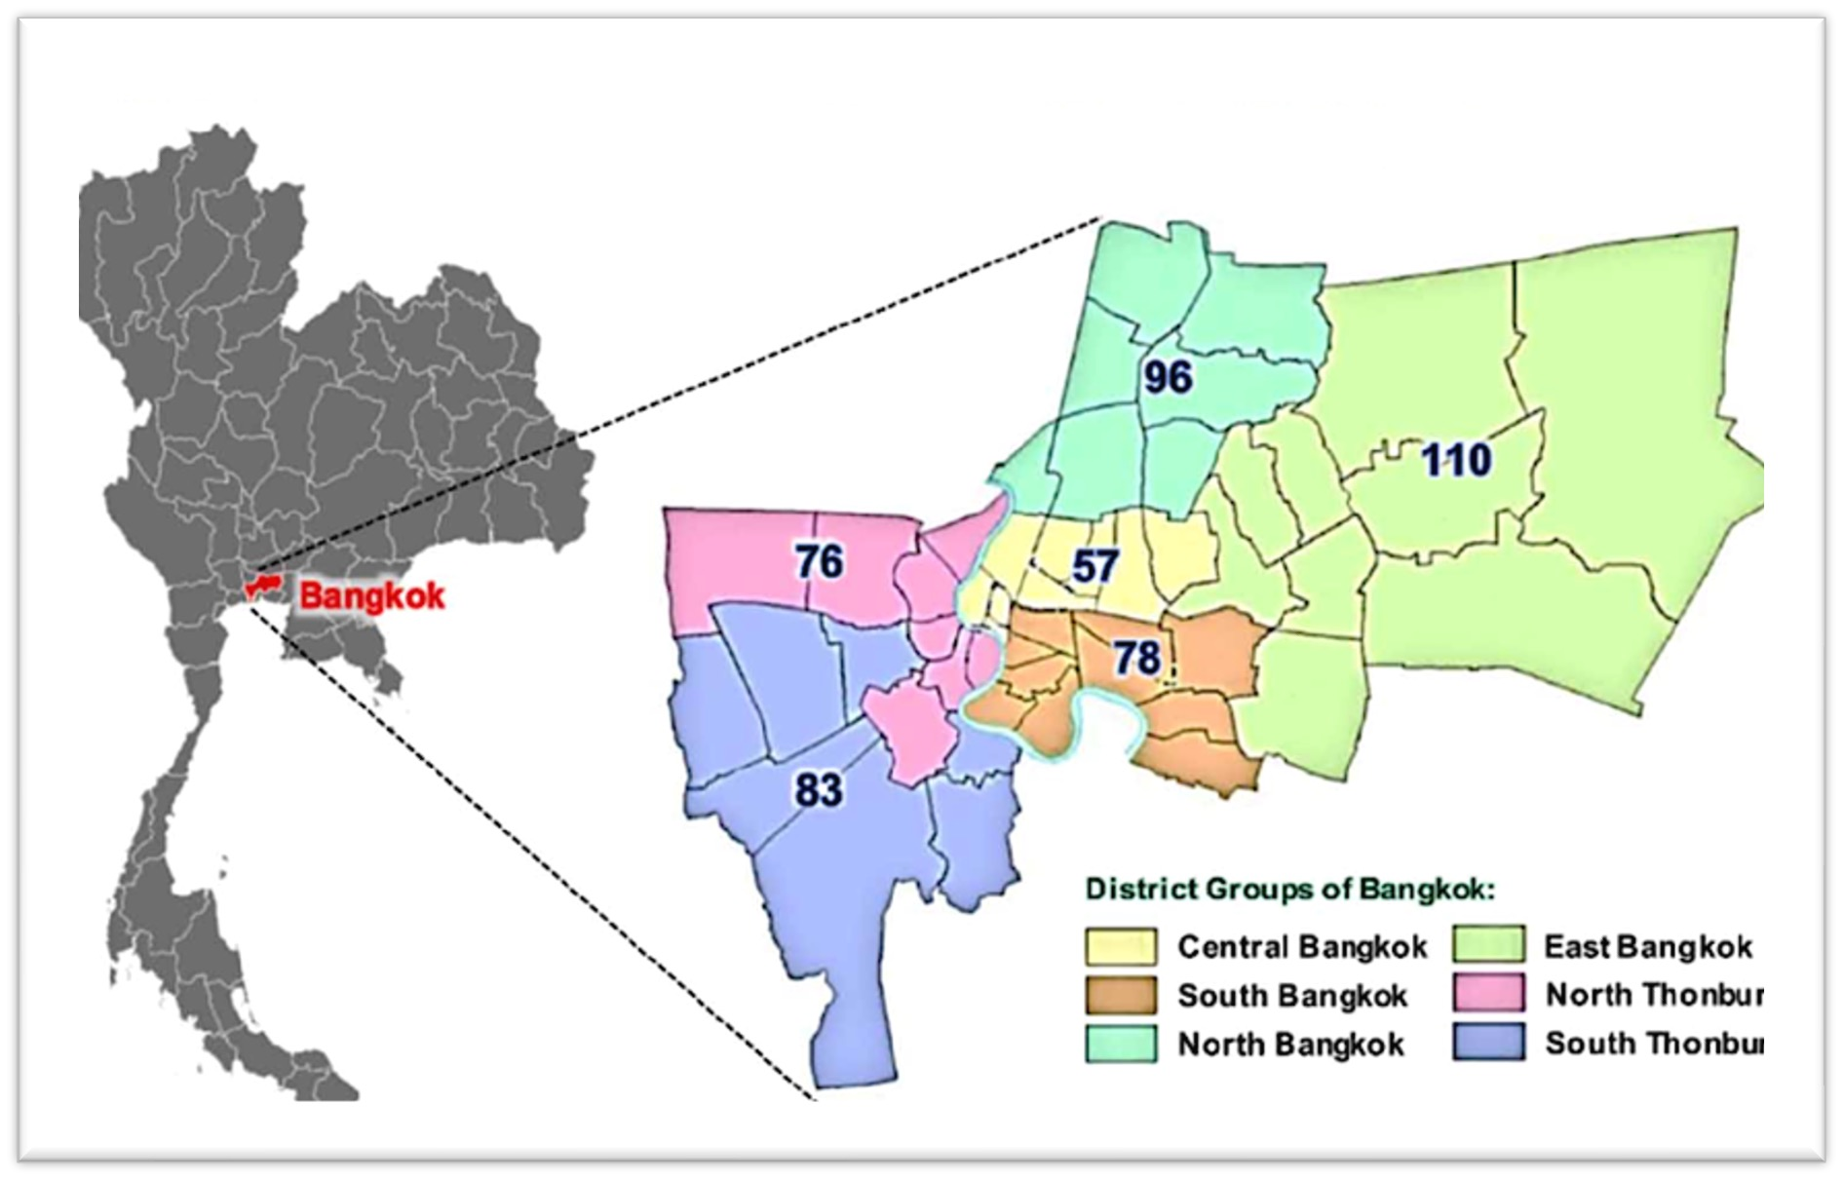
BANGKOK MAP
FINDINGS: LOCATION

Slide 15
FINDINGS: LOCATION (REGIONS)
Insight #6: South Bangkok and Central Bangkok are the most popular regions in listing count, monthly reviews, and also have the highest price.
Listing Count by Region
Monthly Reviews by Region
Avg Price by Region
South Bangkok
Central Bangkok
North Bangkok
North Thonburi
East Bangkok
South Thonburi
53.34%
South Bangkok
Central Bangkok
North Bangkok
North Thonburi
East Bangkok
South Thonburi
0.79
South Bangkok
Central Bangkok
South Thonburi
North Thonburi
East Bangkok
North Bangkok
1902.97
25.04%
0.64
1692.31
7.22%
0.44
1584.26
7.21%
0.43
1434.27
5.22%
0.35
1411.79
1.97%
0.24
1399.81

Slide 16
FINDINGS: LOCATION (REGIONS)
Insight #7: South Bangkok and Central Bangkok are also the pricier regions in for entire home and private room, but not for shared room.
Price by Region (Entire home/apt)
room_type | Entire home/apt
Row Labels | Average of price
South Bangkok Central Bangkok | 1964.78
 | 1828.42
South Thonburi East Bangkok North Bangkok North Thonburi | 1741.76
 | 1633.15
 | 1533.17
 | 1482.81
Grand total | 1861.86
Price by Region (Private room)
room_type | Private room
Row Labels | Average of price
South Bangkok Central Bangkok | 1738.91
 | 1419.47
North Thonburi South Thonburi North Bangkok East Bangkok | 1383.13 1382.09
 | 1260.10
 | 1156.87
Grand total | 1507.57
Price by Region (Shared room)
room_type | Shared room
Row Labels | Average of price
East Bangkok | 1288.00
 | 1005.00
North Bangkok
North Thonburi | 864.94
South Bangkok | 851.39
 | 750.68
Central Bangkok
 | 650.00
South Thonburi
Grand total | 845.96

Slide 17
FINDINGS: LOCATION (DISTRICTS) #1
Lat Phrao
Parthum Wan
Bang Rak Vadhana Yan na wa Khlong Toei
Sathon Suanluang Bang Kho laen Phra Khanong
Bang Na
Dusit Samphanthawong Pom Prap Sattru Phai
Phra Nakhon Phaya Thai Ratchathewi
Wang Thong Lang Huai Khwang Din Daeng Thung khru Bang Khun thain Nong Khaem Bang Bon
Bang Khae Rat Burana Phasi Charoen Nong Chok Khlong Sam Wa Saphan Sung Lat Krabang
Pra Wet Bueng Kum Khan Na Yao
Min Buri Bang Kapi Sai Mai Bang Khen Chatu Chak
Lak Si Don Mueang Bang Sue
Taling Chan Bangkok Yai Bangkok Noi Khlong San Chom Thong Thawi Watthana
Thon buri Bang Phlat
Insight #8: Price varies a lot across districts even within the same region for entire home
4,500
Avg Price Breakdown by Neighborhoods (Entire home/apt)
4,000
3,500
3,000
2,500
2,000
overall average
1,500
1,000
500
0
South Bangkok
Central Bangkok
South Thonburi
East Bangkok
North Bangkok
North Thonburi

Slide 18
FINDINGS: LOCATION (DISTRICTS) #2
Vadhana
Parthum Wan
Bang Rak Khlong Toei Lat Phrao Bang Na Yan na wa
Sathon Bang Kho laen Suanluang Phra Khanong
Pom Prap Sattru Phai Samphanthawong
Phaya Thai
Dusit Huai Khwang Phra Nakhon Ratchathewi Din Daeng
Wang Thong Lang Thawi Watthana
Thon buri Bangkok Yai Chom Thong Khlong San Bangkok Noi Taling Chan Bang Phlat Rat Burana Bang Khae Bang Bon Thung khru
Phasi Charoen Bang Khun thain Nong Khaem Chatu Chak
Don Mueang Bang Sue Bang Khen
Lak Si Sai Mai Khan Na Yao
Khlong Sam Wa Bueng Kum Saphan Sung Bang Kapi Pra Wet
Lat Krabang Nong Chok Min Buri
Insight #9: Same goes for private room but with lower level of variation.
3,000
Avg Price Breakdown by Neighborhoods (Private room)
2,500
2,000
overall average
1,500
1,000
500
0
South Bangkok
Central Bangkok
North Thonburi
South Thonburi
North Bangkok
East Bangkok

Slide 19
FINDINGS: CORRELATION WITH PRICE AND REVIEWS
Insight #11: Accommodates, bedrooms, and bathrooms have stronger correlation with price.
Correlation Coefficient
 | price |  | reviews_per_month
accommodates | 0.52 0.51 |  | 0.14 0.10 | reviews_rating_score
bedrooms |  |  |  | accommodates
bathrooms | 0.47 |  | 0.06 | bedrooms
reviews_per_month | 0.01 |  | 0.03 | bathrooms
reviews_rating_score | -0.01 |  | 0.02 | availability_365
longtitude | -0.02 |  | 0.01 | price
latitute | -0.03 |  | -0.03 | longtitude
availability_365 | -0.05 |  | -0.05 | latitude
minimum_nights | -0.14 |  | -0.18 | minimum_nights

Slide 20



Accommodates and Price
Bedrooms and Price
6000.00
7000.00
6000.00
5000.00
4000.00
3000.00
2000.00
1000.00
0.00
5000.00
4000.00
FINDINGS:
CORRELATION WITH PRICE
3000.00
2000.00
1000.00
0.00
0 2 4 6 8 10 12 14 16 18
0
2
4
6
8
10
12
Bathrooms and Price
Minimum Nights and Price
8000.00
7000.00
6000.00
5000.00
4000.00
3000.00
2000.00
1000.00
0.00
3500.00
3000.00
2500.00
2000.00
1500.00
1000.00
500.00
0.00
0
2
4
6
8
10
0
5
10
15
20
25
30
35

Slide 21
FINDINGS: EXTRA #1
Insight #12: Hosts with identity verified have more reviews, similar with superhost.
4271, 24%
15457, 88%
2038, 12%
NO
12408, 71%
YES
Identity Verified
Superhost
YES
NO
816, 5%
 | Average price | Reviews per month
Not verified | 1982.10 | 0.05
Verified | 1717.31 | 0.75
 | Average price | Reviews per month
Not superhost | 1757.60 | 0.45
Superhost | 1732.64 | 1.24
(blank) | 1685.62 | 0.98

Slide 22
FINDINGS: EXTRA #2
Insight #13: Listing that is instant bookable tend to have more reviews.
8418, 48%
9077, 52%
YES
Instant Bookable
NO
 | Average price | Avg reviews per month
Not instant bookable | 1790.49 | 0.44
Instant bookable | 1702.50 | 0.91

Slide 23
RECOMMENDATIONS
Room type, stay term, region, #bedrooms, #bathrooms, accommodates are reliable factors to take into account when setting your price.
Allowing short-term stay could boost your listing popularity and revenue, especially for entire home and private room.
Pricing slightly lower than regional average is better to ensure revenue as there are many listings with no review having above average price across room types and regions.
Using districts’ average price as a reference is unreliable for the less popular districts because of smaller sample size.
Verify identity now and aim to be a super host in a long run. Verified hosts have 15 times more reviews than non-verified ones.

Slide 24
RECOMMENDATIONS: PRICING MODEL
Room Type
+
Region
+
Bedrooms & Bathrooms
+
Accommodates
Suggested Price Range
(*already include 6-18% guest side service fee)

Slide 25
RECOMMENDATIONS: PRICING MODEL
“Suggested Price Range”
+
Service Fee (host-side; 3%)
+
Cleaning Fee (300-600)
+ Tax (7%)

Slide 26

Suggested price range should be taken as a guideline.
Certain amenities may have strong influence on price (further analysis needed).
Other factors (outside of the dataset) such as property photos, room size, proximity to MRT or tourist landmarks, etc. could have strong correlation with price and number of bookings.
FINAL REMARKS

